Slide 1
ML Project or maybe DL Project
Notes:
ML Visuals is a new collaborative effort to help the machine learning community in improving science communication by using more professional, compelling and adequate visuals and figures. You are free to use the visuals in your presentations or blog posts. You don’t need to ask permission to use any of the visuals but it will be nice if you can provide credit to the designer/author (author information found in the slide notes).
This is a project made by the dair.ai community and maintained in this GitHub repo. Our community members will continue to add more common figures and basic elements in upcoming versions. Think of this as free and open artefacts and templates which you can freely and easily download, copy, distribute, reuse and customize to your own needs. I am maintaining this set of slides on a bi-weekly basis where I will regularly organize and keep the slides clean from spam or unfinished content.
IMPORTANT NOTE: Please don’t request editing permission if you do not plan to add anything to the slides. If you want to edit the slides for your own purposes, just make a copy of the slides.
Contributing: To add your own custom figures, simply add a new slide and reuse any of the basic visual components (remember to request edit permissions). We encourage authors/designers to add their visuals here and allow others to reuse them. Make sure to include your author information (in the notes section of the slide) so that others can provide the proper credit if they use the visuals elsewhere (e.g. blog/presentations). Add your name and email just in case someone has any questions related to the figures you added. Also, provide a short description of your visual to help the user understand what it is about and how they can use it. If you need "Edit" permission, just click on the "request edit access" option under the "view only" toolbar above or send me an email at ellfae@gmail.com. If you have editing rights, please make sure not to delete any of the work that other authors have added. You can try to improve it by creating a new slide and adding that improved version (that’s actually encouraged).
Downloading a figure from any of the slides is easy. Just click on File→Download→(choose your format).
If you need help with customizing a figure or have an idea of something that could be valuable to others, we can help. Just open an issue here and we will do our best to come up with the visual. Thanks.
Feel free to ask us anything related to this project in our Slack group.

Slide 2
Here is an overview of what I am going to do
Notes:
Note:
Basic components go here.

Slide 3
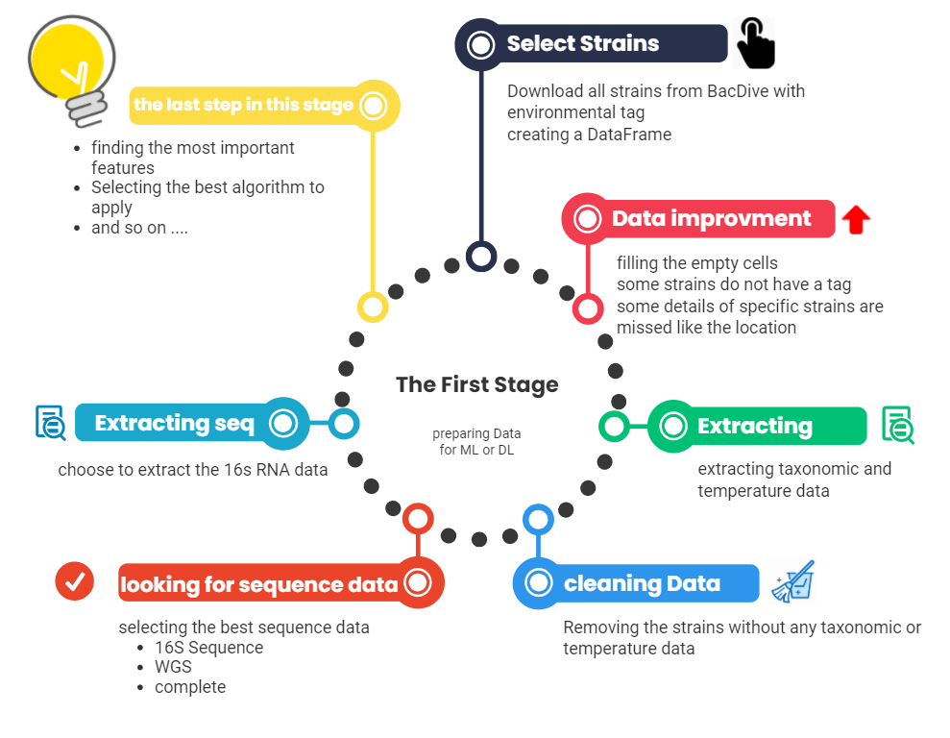

Slide 4
Stage one First step
We are going to download all strains from BacDive
With the specific tag (we start by environmental Tag)
Notes:
Note:
This is the header I use for the dair.ai NLP Newsletter
You can change the gradient of each component
Author: Elvis Saravia

Slide 5
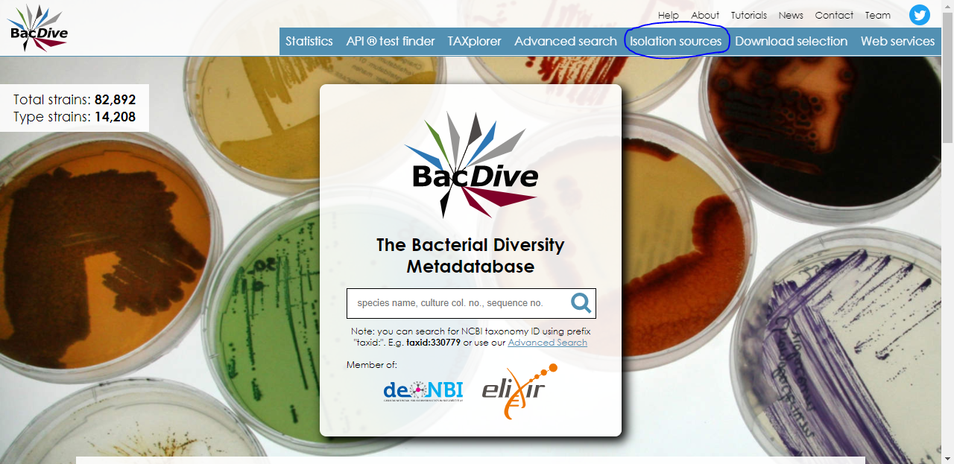

Slide 6
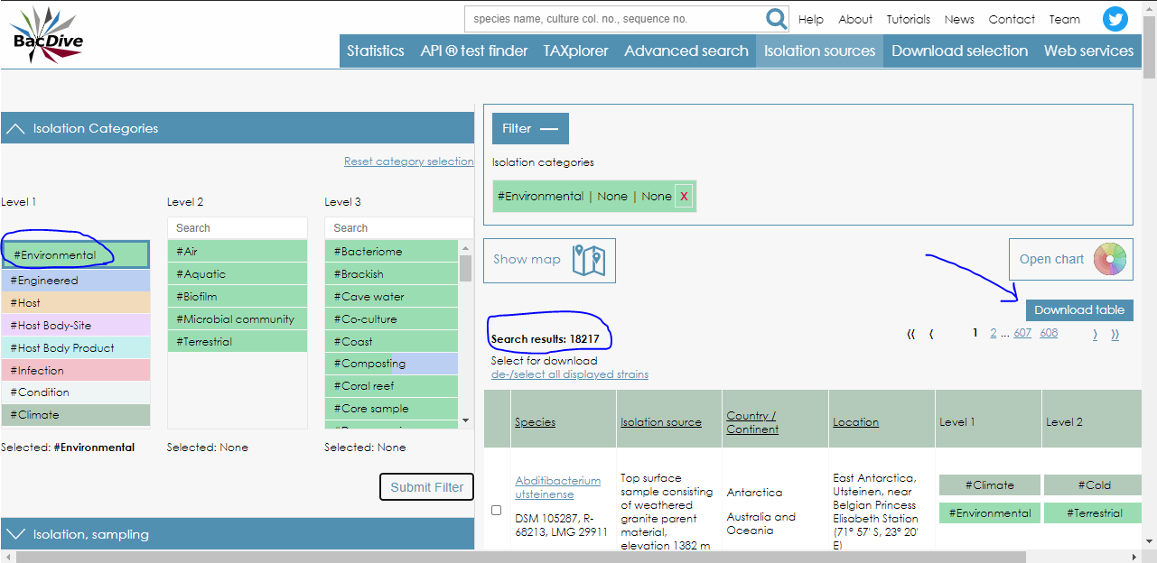

Slide 7
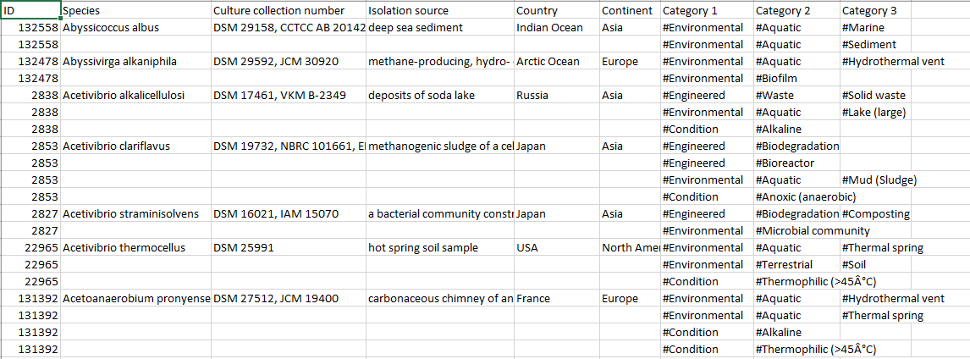
step1.export_bacdive_iso_table before cleaning

Slide 9
Second step

Slide 10
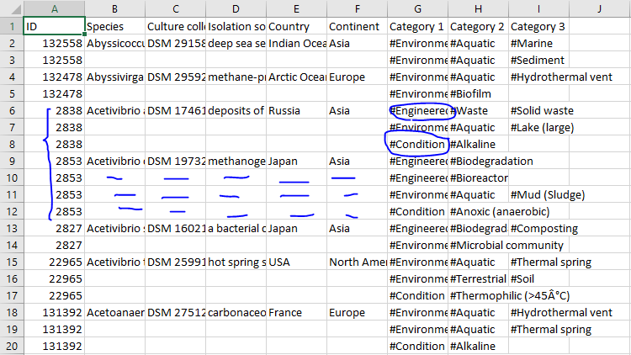
As you can see the main table is full of redundancy and there are tags other than #Enviroment and also lots of empty cells

Slide 11
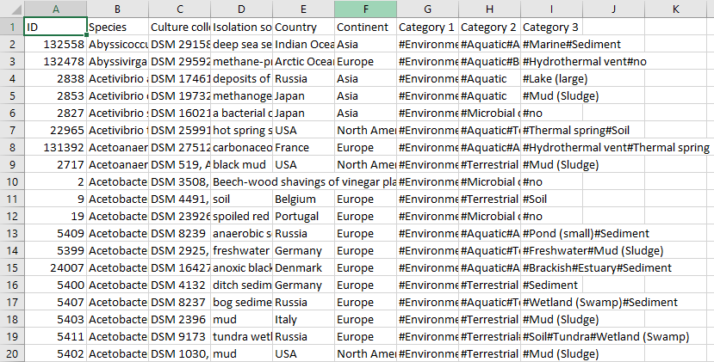
I used the python code (no.4) to create a new table, removing all the mistakes and filling the missed data 18040 strains

Slide 13
Third step

Slide 14
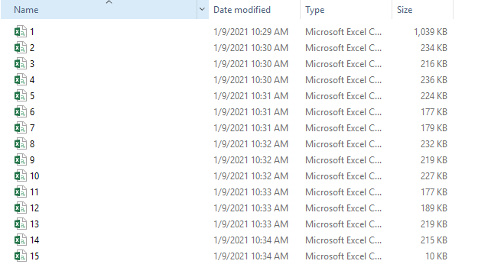


Extracting taxonomic and temperature details for each strain in different excel files, then we combined them together.

Slide 15
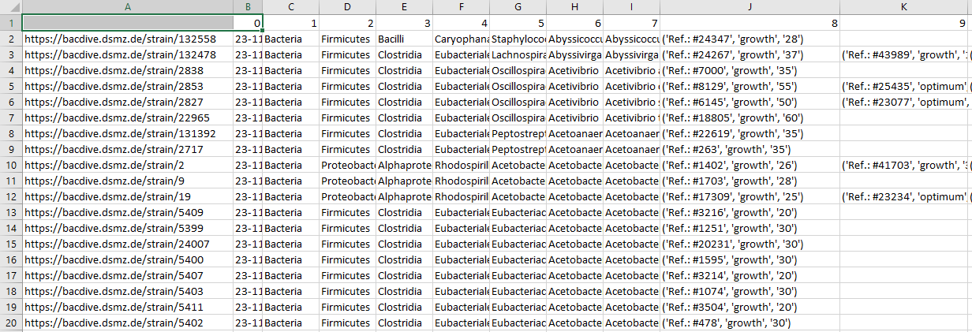
The result is as follow:

Slide 17
4rd step Another cleaning step

Slide 18
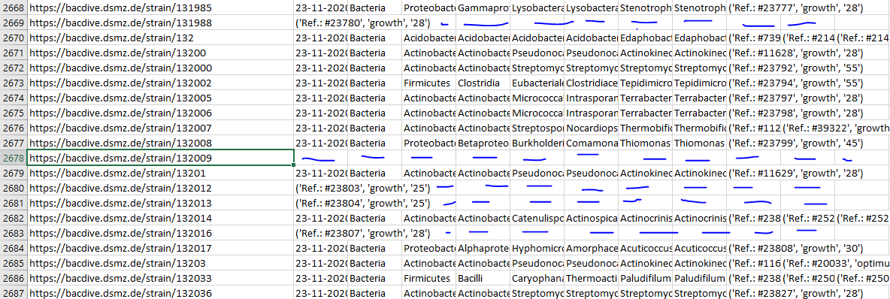
finding the starins with no taxonomic data (or defective data): 436 rows

Slide 19
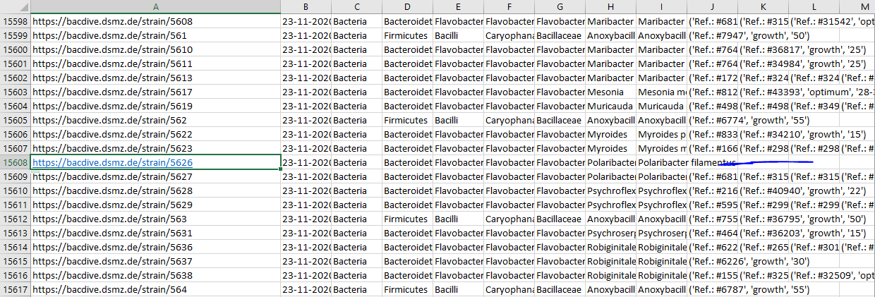
finding strains with no temperature data :

Slide 20

18041 strains
(stage1_step3_web scrapping output)
stage1_step4_sub1.2
436 strains with no taxonomic data
stage1_step4_sub1.1
17604 strains with taxonomic data
stage1_step4_sub2.1
13400 data with temperature data
stage1_step4_sub2.2
4204 data without temperature data

Slide 21
In the end: we started with 18040 strains
436
strains without taxonomic data
4204
strains with no temperature data
13400 strains with complete data
13400 strains with complete data

Slide 22


Until now we have:
ID
ID
Tag
BacDive Link
Taxonomic data
species
country
Temperature data(growth, optimum,…)
Isolation source

Slide 24
5th step

Slide 25
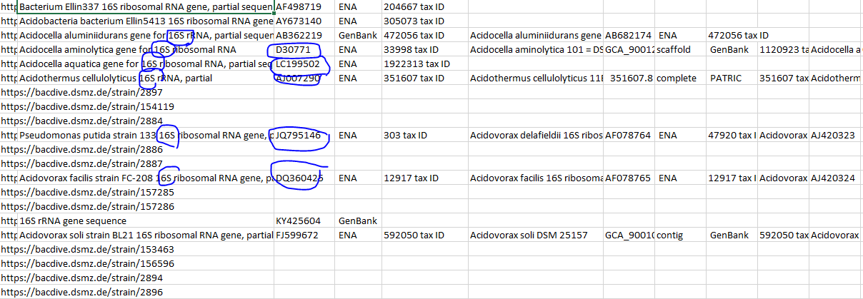
all_availible_seq_in_Bacdive 3022 WGS, 11527 16s,2029 complete seq

Slide 26
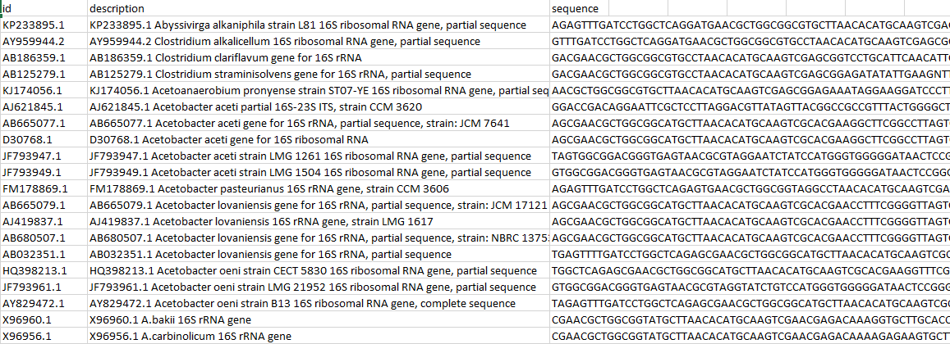
All_seq_data

Slide 27


End of first stage Until now we have:
ID
Description
sequence

